Slide 1
Building ML model to predict cardiovascular disease
Emmanuel Mensah
Krishna Arisetty
Soumya Ranjan Mallick

Slide 2
Hypothesis Statement
A predictive model utilizing age, cholesterol level, chest pain, blood pressure, blood sugar level, ecg, exercise-induced angina, resting blood pressure, maximum heart rate achieved, and presence of heart disease as predictors will accurately predict the likelihood of an individual developing heart disease.

Slide 3
Heart disease dataset: Widely studied dataset with patient information for developing predictive models to diagnose and treat heart disease.
K. Sathya et al. (2020): Developed a predictive model for heart disease using machine learning techniques.
Methodology: Used heart disease dataset for training and testing.
Results: Achieved an accuracy of 90.37% with the developed model.
Literature Review

Slide 4
Objective
Approach: Use unsupervised clustering to group similar patients together based on medical history, then use this clustering information to assign labels and convert data into a supervised format for training a prediction model.
Steps:
Collect data on patient demographics and medical history.
Preprocess and clean data.
Use unsupervised clustering to group similar patients together.
Assign labels based on clustering and convert data into a supervised format.
Train a supervised learning model to predict the likelihood of heart disease.

Slide 5
Model Architecture
Data Set
Unsupervised learning
New Observation
Supervised learning
Model Building
Predictive/ Classification

Slide 6
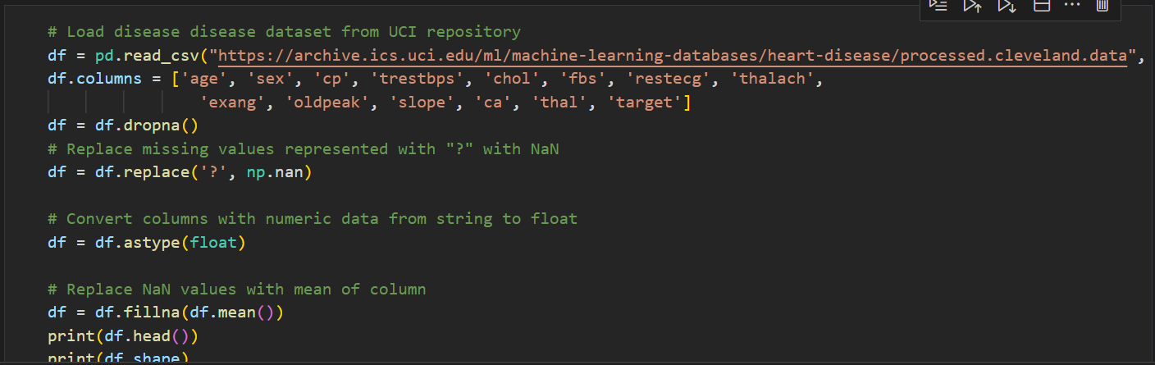
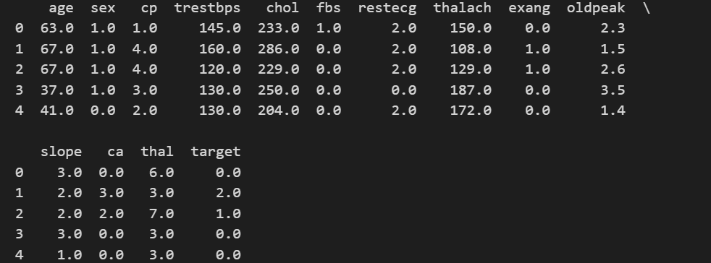
Model Building
EDA

Slide 7
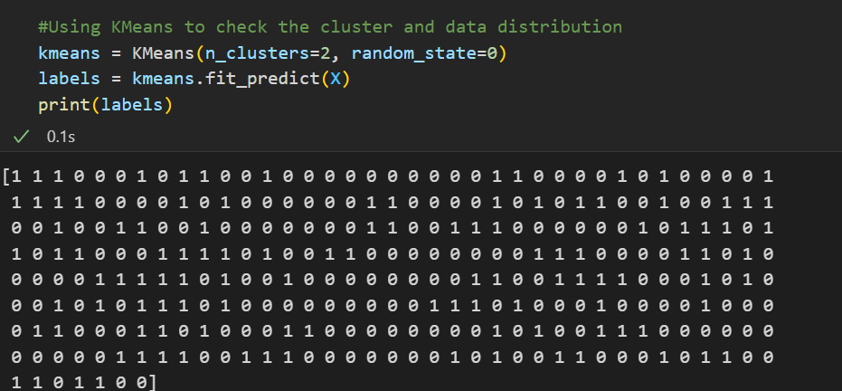
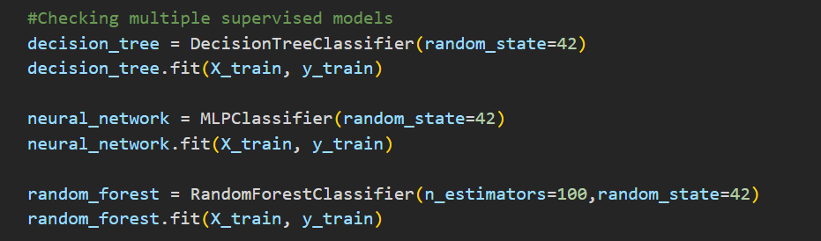
Model Building
Unsupervised Model
Supervised

Slide 8
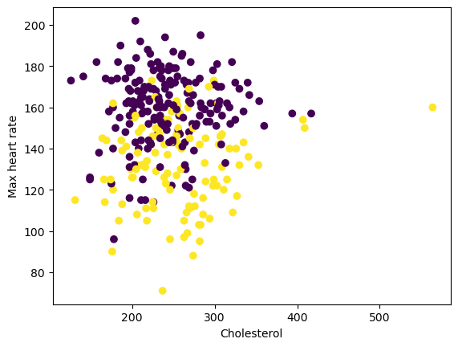
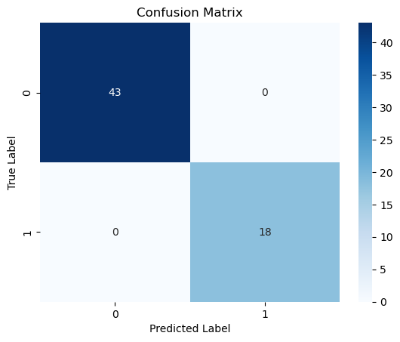
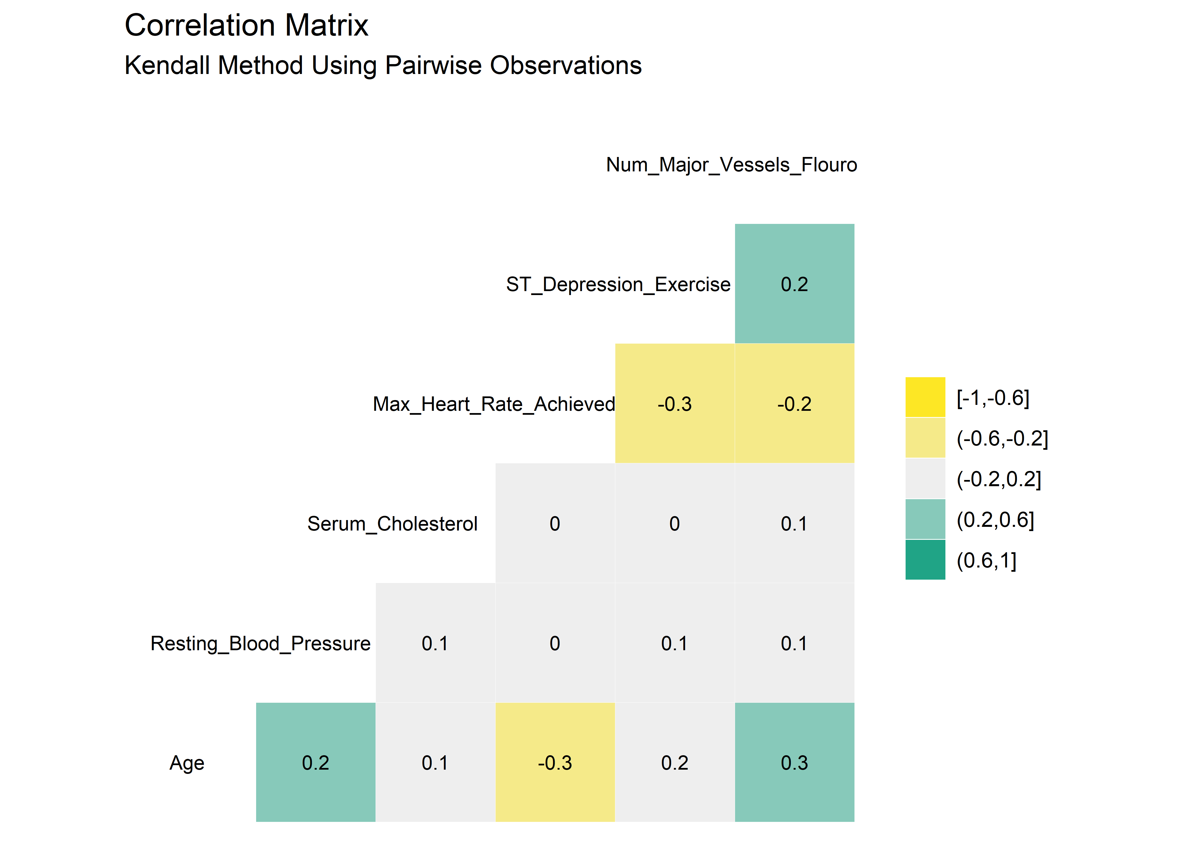
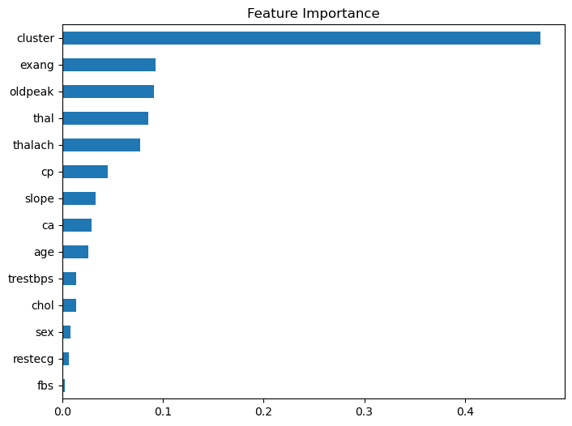
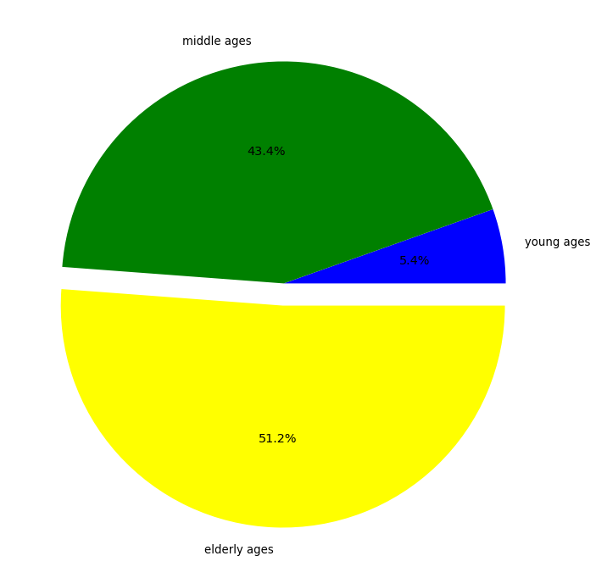
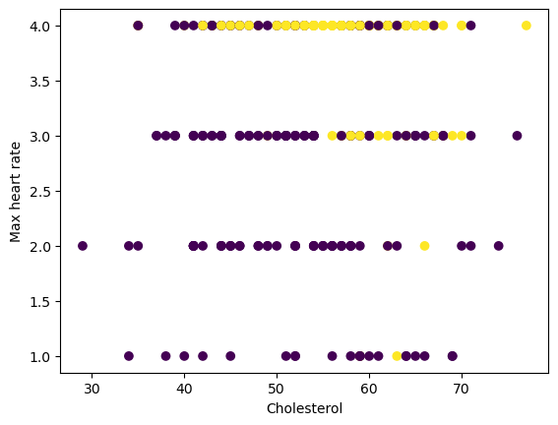
Illustration

Slide 9

CONCLUSION
In conclusion, the results suggest that the random forest algorithm is the most suitable model for predicting the outcome using the given predictors, as it demonstrated 100% accuracy across all three algorithms when all required parameters were verified.

Slide 10

Q&A
Thank You!

